Slide 1
DANIAN.J
PDF STEGANOGRAPHY
3/21/2024 Annual Review

Slide 2
PROJECT TITLE
Implementation of PDF steganography using python
3/21/2024 Annual Review

Slide 3


AGENDA
Problem Statement (Should not include solution)
Proposed System/Solution
System Development Approach (Technology Used)
Algorithm & Deployment
Result (Output Image)
Conclusion
Future Scope
References
3/21/2024 Annual Review

Slide 4

PROBLEM STATEMENT
PDF steganography involves hiding information within a PDF file without affecting its visual appearance or functionality
3/21/2024 Annual Review

Slide 5

PROJECT OVERVIEW
PDF steganography is a technique used to hide secret messages within PDF files without altering their visual appearance. It involves embedding the secret message in the metadata or content of the PDF file, making it difficult to detect without specific knowledge or tools.
Key Components:
Embedding: Techniques such as modifying metadata, hiding text in unused areas, or using invisible ink to embed the secret message in the PDF file.
Extraction: Reverse techniques to extract the hidden message from the steganographic PDF file.
Security: Encryption of the secret message before embedding to enhance security.
User Interface: Simple interface for users to interact with the steganography program.
File Handling: Reading, writing, and manipulating PDF files using libraries like PyPDF2.
Documentation: Clear documentation for users on how to use the steganography program effectively.
3/21/2024 Annual Review

Slide 6

WHO ARE THE END USERS?
End users for PDF steganography can vary based on the purpose and context of the steganographic activity. Some potential end users include:
Researchers and Students: Studying steganography as part of their academic curriculum or research projects.
Security Professionals: Testing and evaluating the security of PDF files and exploring methods to detect or prevent steganographic activities.
Law Enforcement Agencies: Investigating cases involving covert communication or data hiding within PDF files.
Digital Forensics Experts: Analyzing PDF files for hidden information or malicious content.
Data Privacy Advocates: Using steganography as a means to protect sensitive information within PDF files.
Journalists and Whistleblowers: Concealing sensitive information or messages within PDF documents for secure communication.
Software Developers: Integrating steganographic features into PDF reader applications or security tools.
General Users: Exploring steganography as a hobby or for educational purposes, with an interest in digital security and privacy.
3/21/2024 Annual Review

Slide 7
Proposed Solution
This proposed solution aims to address some of the key challenges associated with pdf steganography, focusing on improving data capacity,security, and robustness.Core Techniques:
Adaptive Data Embedding:The system analyzes the chosen function (e.g., SHA-256) and the type of data to be hidden. Based on this analysis, it selects an optimal embedding strategy. This could involve:
LSB Modification: For specific data types (e.g., small text messages) where preserving higher-order bits is crucial, the system might utilize LSB modification on a subset of bits within the hash value.Parity Bit Flipping: For data with more redundancy, the system could strategically flip parity bits within the hash to represent hidden data. This approach aims to minimize disruption to the overall hash value.
Error Correction Integration:The system incorporates an error-correcting code (ECC) like Hamming codes or Reed-Solomon codes into the hidden data before embedding. This adds redundancy and allows for correcting potential errors that might occur during transmission.
Key Management:A secure key exchange mechanism (e.g., Diffie-Hellman key exchange) is employed to establish a shared secret key between sender and receiver. This key is used to determine specific bit positions within the hash or control the flipping patterns for data embedding.
Ethical Considerations:This solution should be used in compliance with all relevant data privacy and communication regulations.Methods for disclosing the use of steganography within communication channels, potentially through pre-defined markers, should be incorporated to promote responsible use.

Slide 8
System Approach
The PDF based steganography has minimal system requirements and can run on most modern computers. Here's a breakdown:
Software:Python 3 (or compatible version) - The code is written in Python and requires a Python interpreter to be installed. Python is freely available for most operating systems.This imports the hashlib library, which provides functions for various cryptographic hash algorithms like MD5, SHA-256, etc.
Hardware:No specific hardware requirements - This code doesn't perform computationally intensive tasks and can run on any computer capable of running Python.

Slide 9
Algorithm & Deployment
Algorithm for PDF Steganography:
1. **Embedding Algorithm:
- Input: Cover PDF file, secret message
- Convert the secret message into a binary format.
- Choose a steganographic technique (e.g., modifying metadata, hiding text in unused areas).
- Embed the binary message using the chosen technique.
- Output: Steganographic PDF file
2. **Extraction Algorithm:
- Input: Steganographic PDF file
- Extract the hidden binary message using the reverse of the embedding technique.
- Convert the binary message back into the original text message.
- Output: The extracted secret message
Deployment for PDF Steganography:
1. **Development Environment:**
- Use Python programming language for development.
- Utilize PyPDF2 library for reading and writing PDF files.
- Optional: Use cryptography library for encryption.
2 . **Deployment Options:**
- Standalone Application: Package the program as a standalone application for users to download and use on their computers.
- Web Application: Deploy the program as a web application for online use, possibly using frameworks like Flask or Django.
- Cloud Deployment: Host the application on cloud platforms like AWS, Azure, or Google Cloud for easy access and scalability.
3. **Security Considerations:**
- Use strong encryption algorithms to protect the hidden message.
- Implement secure authentication and access controls for the application.
- Regularly update the application to patch any security vulnerabilities.
4 **Documentation and Support:**
- Provide clear documentation for users on how to use the application.
- Offer support channels for users to report issues or seek assistance.

Slide 10
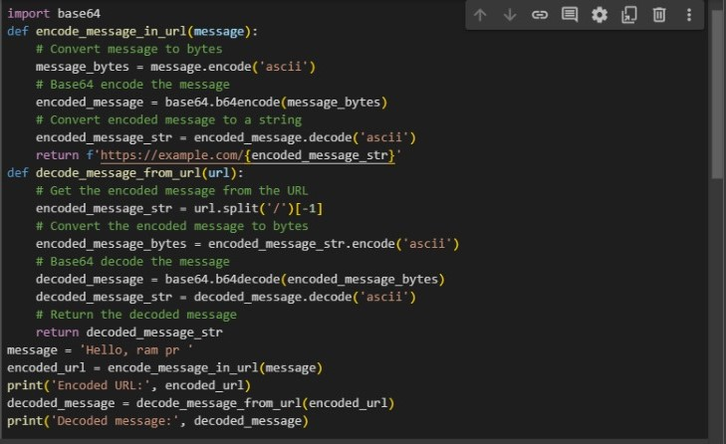
MODELLING
3/21/2024 Annual Review

Slide 11

RESULTS
In general, the results of image steganography encryption include:
- Embedding of secret data within the image without visibly altering it
- Ensuring that the embedded data is hidden and secure from unauthorized access
- Choosing an appropriate algorithm or method for encrypting the data within the image
- Generating a stego image that can be shared or transmitted without suspicion
On the other hand, the results of image steganography decryption involve:
- Extracting the hidden data from the stego image using a decryption algorithm or key
- Reconstructing the original data that was encrypted within the image
- Ensuring that the extracted data is accurate and unaltered from the original
- Verifying the authenticity of the extracted data and confirming it against the original information
Demo Link
3/21/2024 Annual Review

Slide 12
Conclusion
PDF steganography is a fascinating field that allows for the covert embedding of messages within PDF files. By leveraging techniques like modifying metadata or hiding text in unused areas, it's possible to hide information in plain sight. However, it's crucial to note that steganography should be used responsibly and ethically, as it can be misused for illicit purposes. When used appropriately, PDF steganography can serve as a valuable tool for secure communication and data hiding.

Slide 13
Future scope
The future scope for PDF steganography is vast and promising, with several potential advancements and applications:
Enhanced Security: Future developments may focus on improving the security of steganographic techniques, such as implementing more robust encryption algorithms and authentication mechanisms to protect hidden messages from unauthorized access.
Deep Learning Integration: Integration of deep learning models for steganalysis, which is the detection of hidden messages, could lead to more effective detection methods and improved security measures against steganography.
Multi-Media Steganography: Expanding steganographic techniques to include multimedia files like videos and audio, allowing for the hidden embedding of messages within these files.
Cloud-Based Steganography: Utilizing cloud computing resources for more efficient and scalable steganographic operations, enabling the secure storage and transmission of hidden messages.
Cross-Platform Compatibility: Developing steganographic tools that are compatible across different operating systems and devices, ensuring seamless integration and usability.
Quantum Steganography: Exploring the use of quantum computing principles for steganography, which could potentially lead to more secure and efficient methods of hiding messages.
Application in IoT and Blockchain: Applying steganography techniques in Internet of Things (IoT) devices and blockchain technology for secure communication and data integrity.
Biometric Steganography: Exploring the use of biometric data (e.g., fingerprints, iris scans) for steganographic purposes, which could enhance the security and uniqueness of hidden messages.

Slide 14
References
List and cite relevant sources, research papers, and articles that were instrumental in developing the proposed solution. This could include academic papers on bike demand prediction, machine learning algorithms, and best practices in data preprocessing and model evaluation.

Slide 15
THANK YOU

